Slide 1
Data Visualizations

Slide 2
Why do we need visualizations?

Slide 3
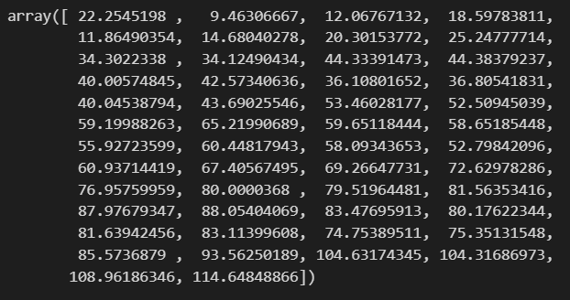
Before

Slide 4
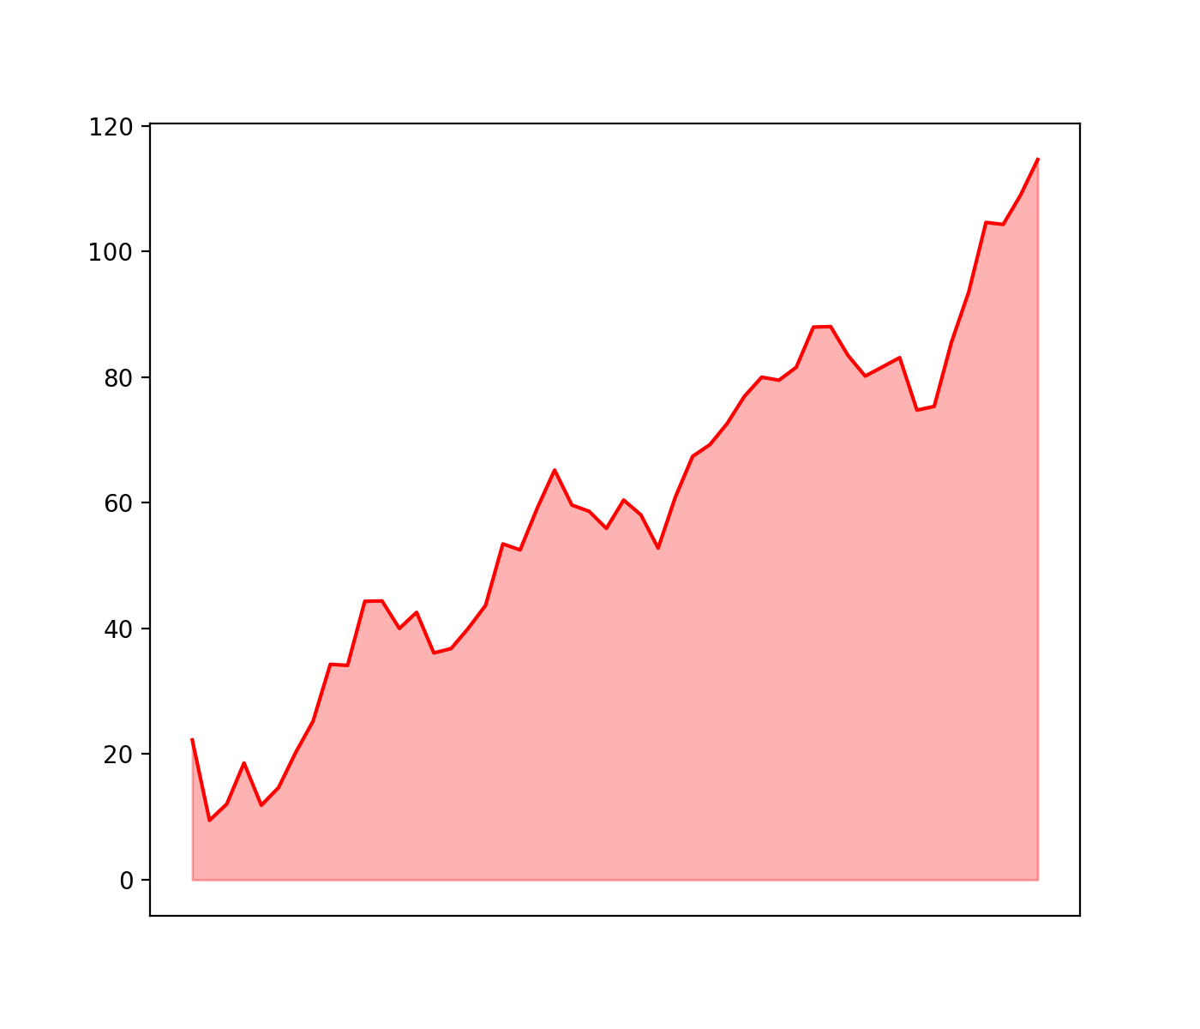
After

Slide 5
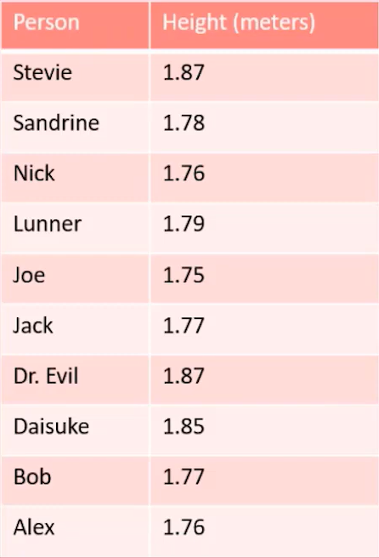

Slide 6
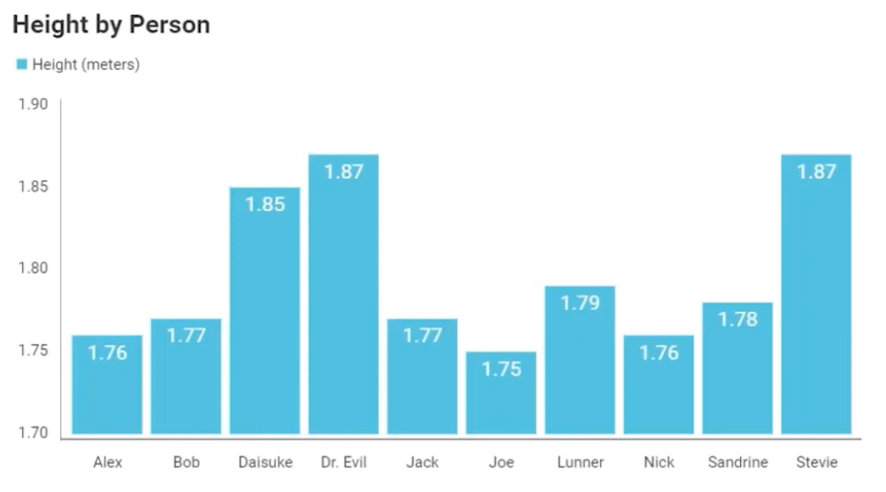

Slide 7
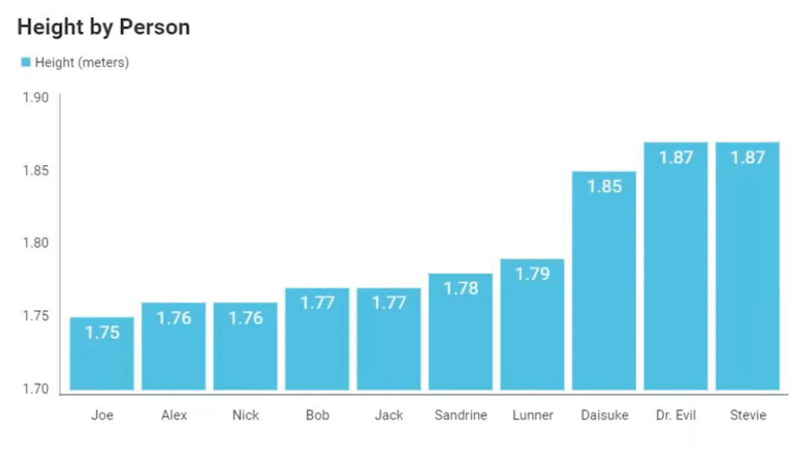

Slide 8
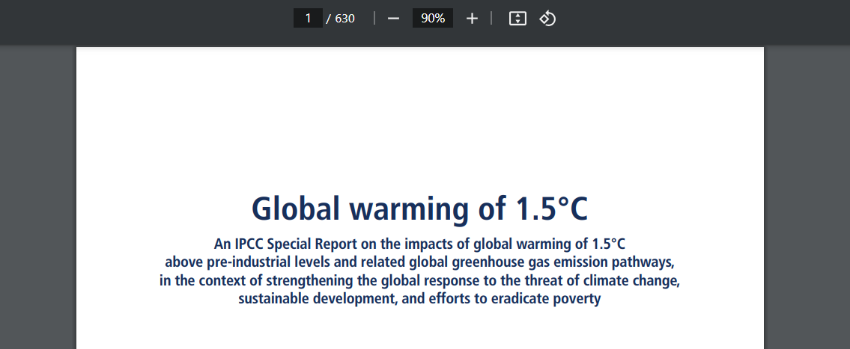

Slide 9



Slide 10
Directory of visualizations

Slide 11
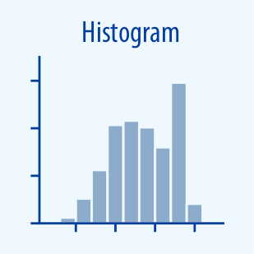
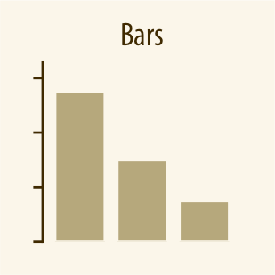
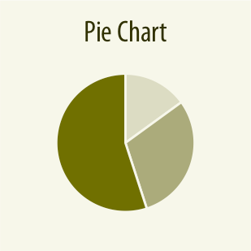
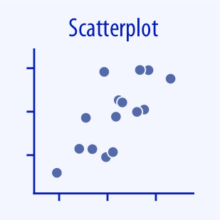
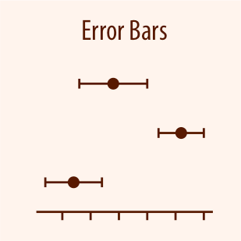
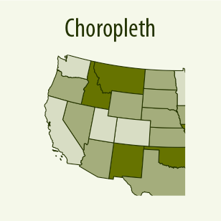
Distributions
Amounts
Proportions
x-y relationships
Uncertainty
Geospatial

Slide 12
Main libraries

Slide 13
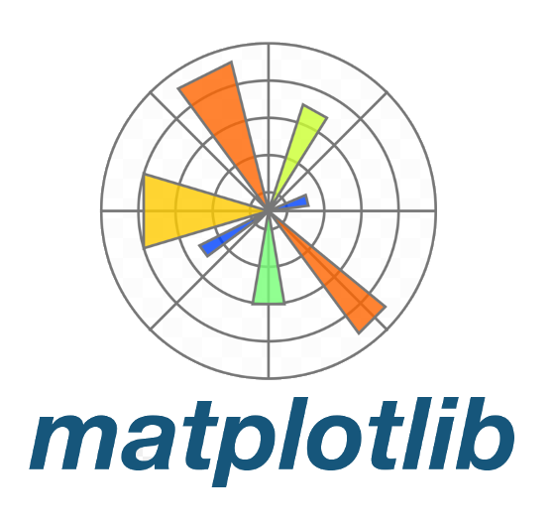
Main libraries
Fundamental

Slide 14

Main libraries
Fundamental

Slide 15

Main libraries
Fundamental
Interactive

Slide 16
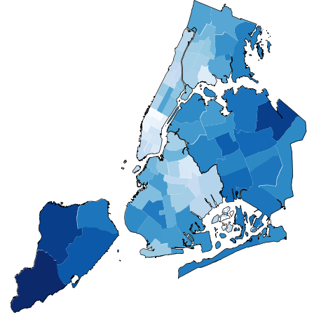
Main libraries
Fundamental
Interactive
Geospatial
Geoplot

Slide 17

Main libraries
Fundamental
Interactive
Geospatial
Geoplot

Slide 18
Other visualization apps

Slide 19



Other visualization apps

Slide 20
How to visualize data distribution

Slide 21
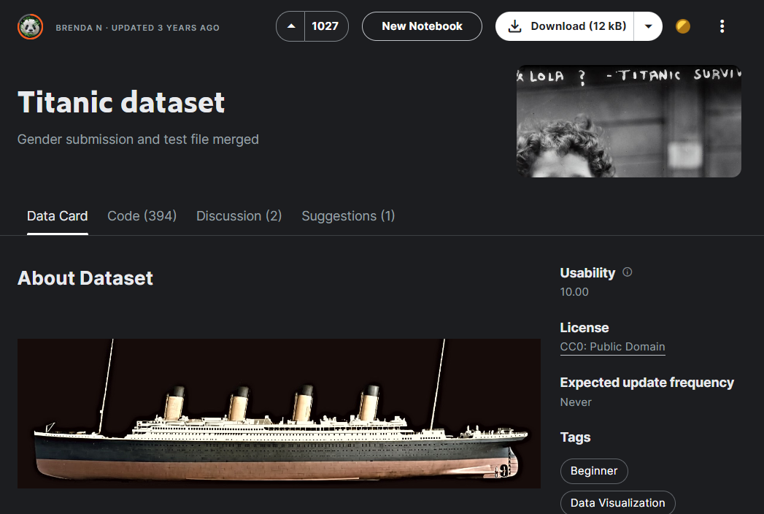

Slide 22
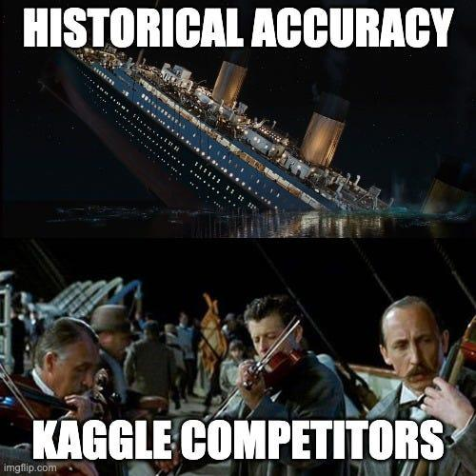

Slide 23
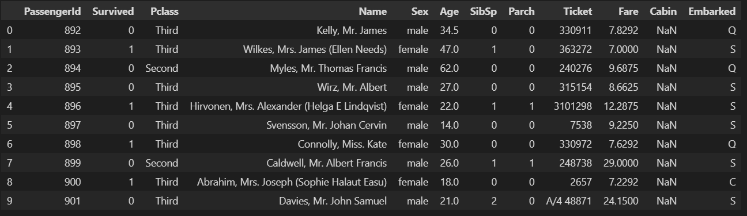

Slide 24
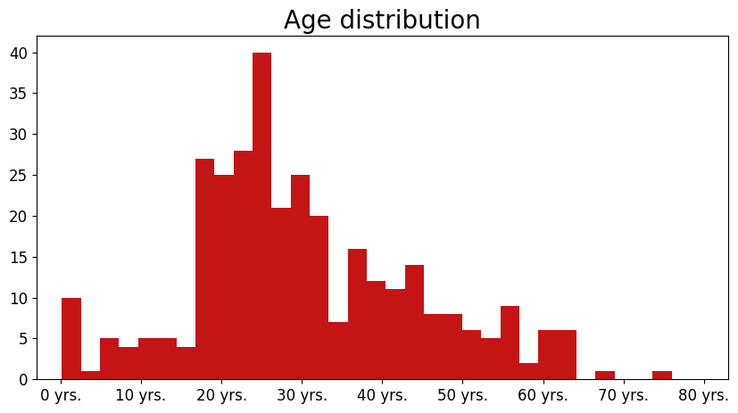
Histogram

Slide 25
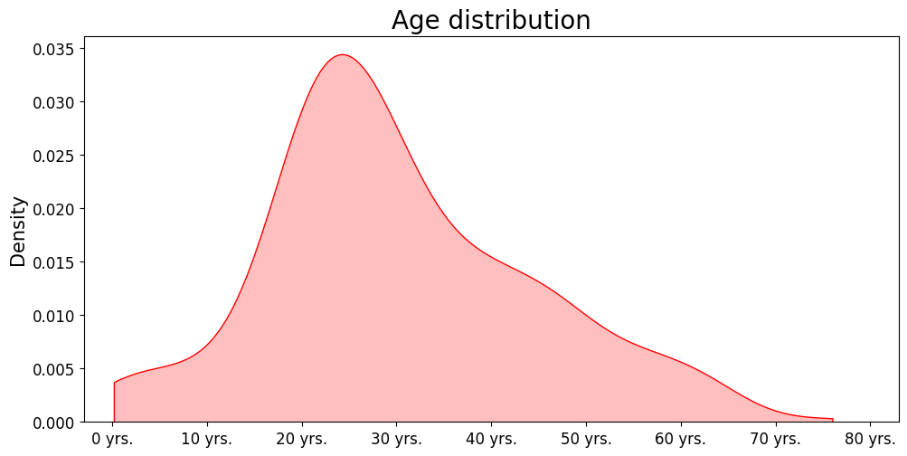
Density plot

Slide 26
KDE

Slide 27
KDE - Kernel Density Estimator

Slide 28

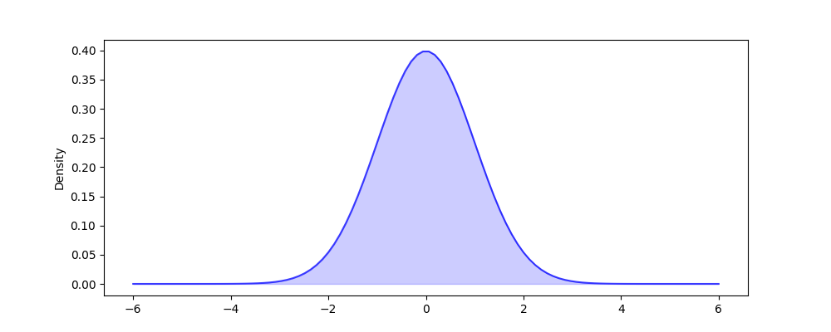
Density plot

Slide 29
Density plot

Slide 30

Density plot

Slide 31
Density plot
h - kernel bandwidth

Slide 32

Density plot
h - kernel bandwidth

Slide 33
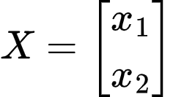
Density plot

Slide 34

Density plot

Slide 35
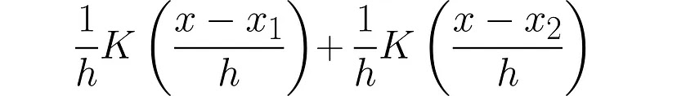
Density plot

Slide 36
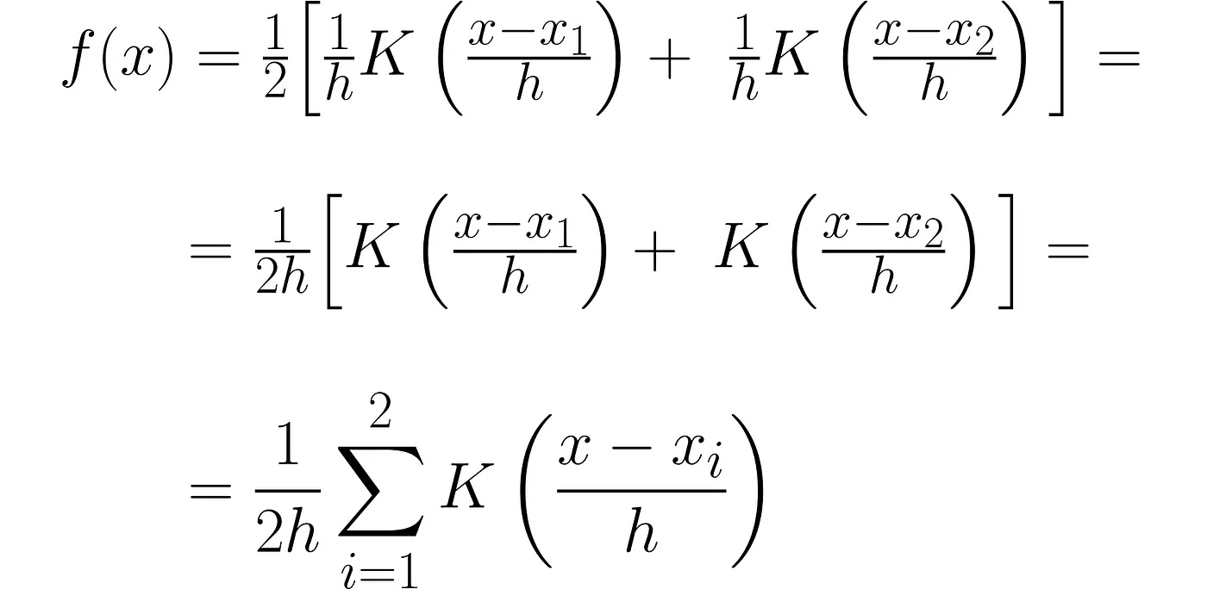
Density plot

Slide 37
Density plot

Slide 38
Density plot

Slide 39
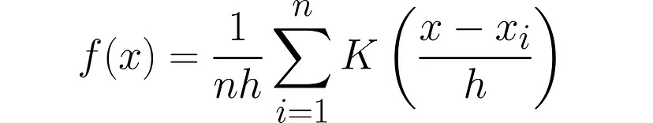
Density plot

Slide 40
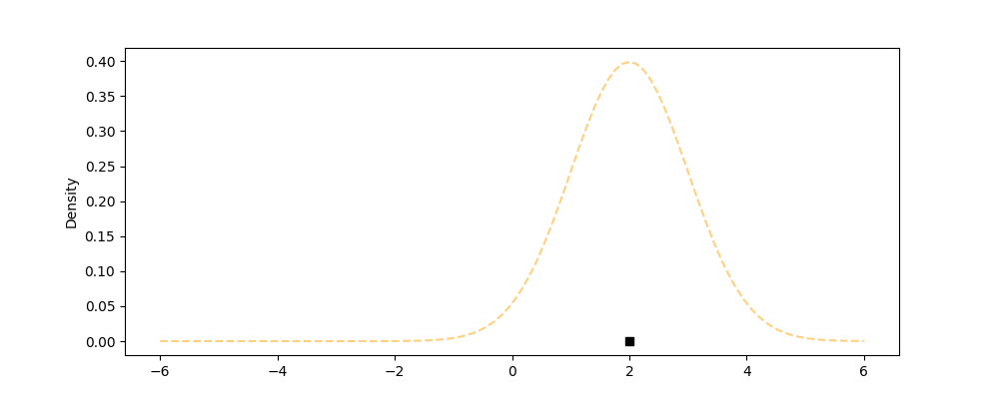
Density plot

Slide 41
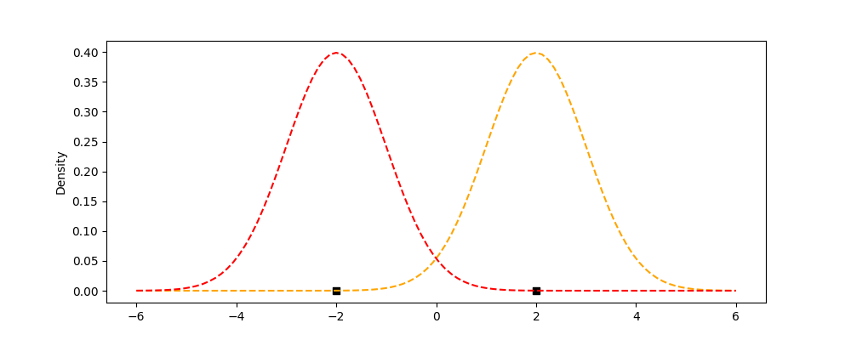
Density plot

Slide 42
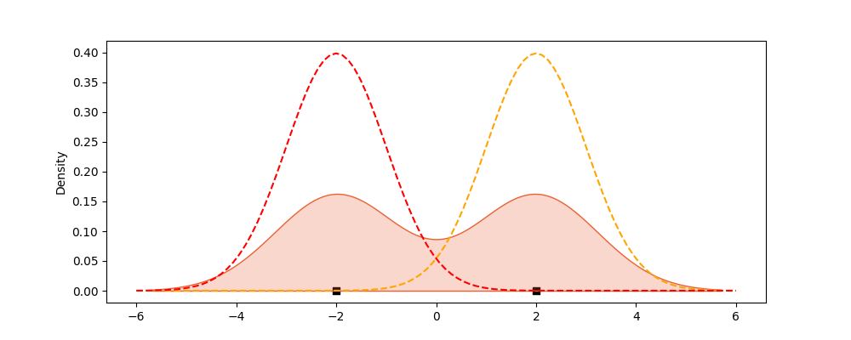
Density plot

Slide 43
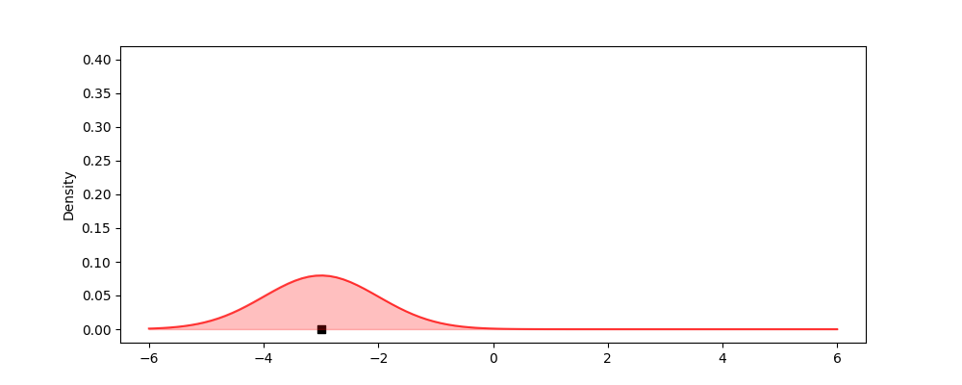
Density plot

Slide 44
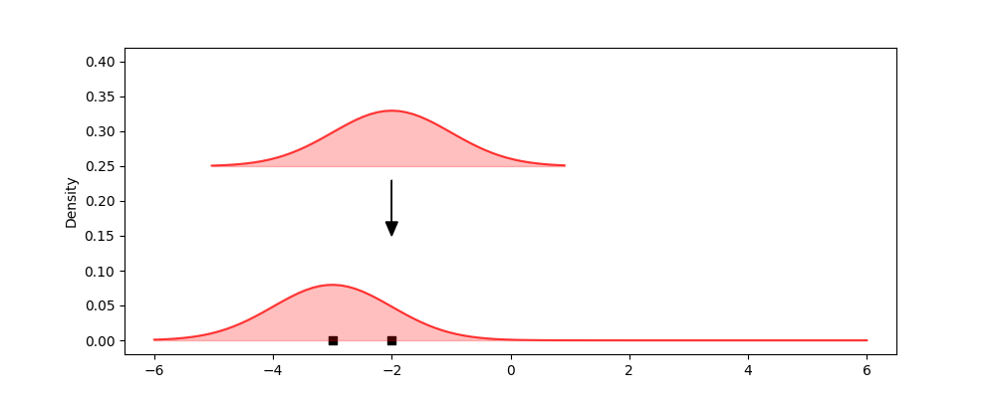
Density plot

Slide 45
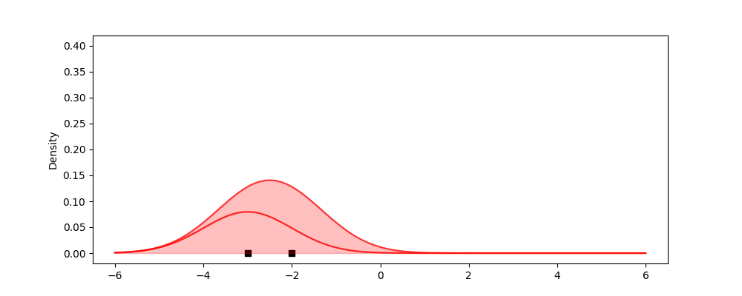
Density plot

Slide 46
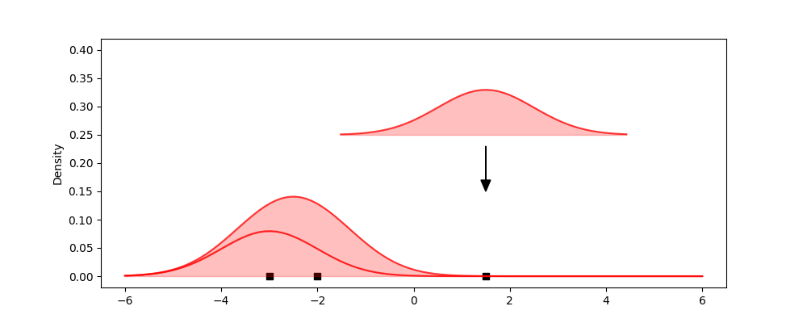
Density plot

Slide 47
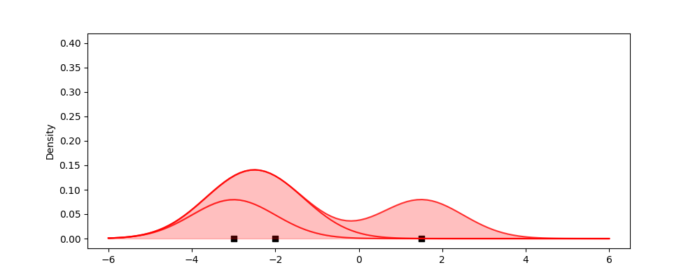
Density plot

Slide 48
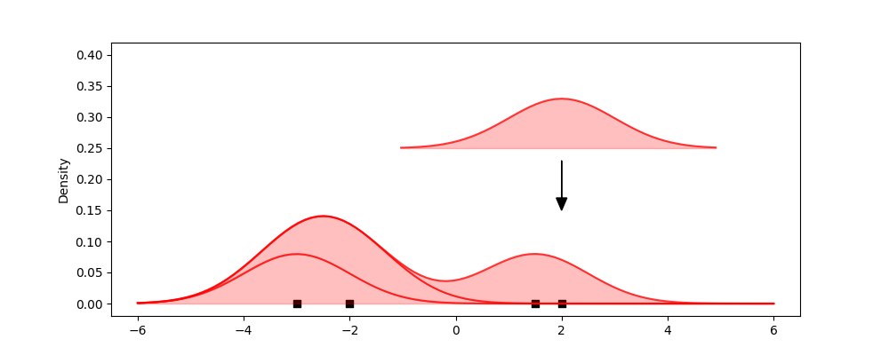
Density plot

Slide 49
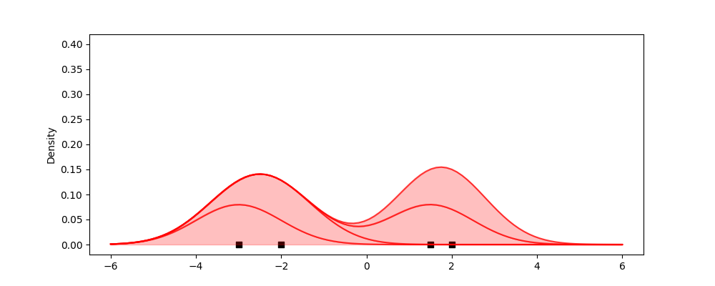
Density plot

Slide 50
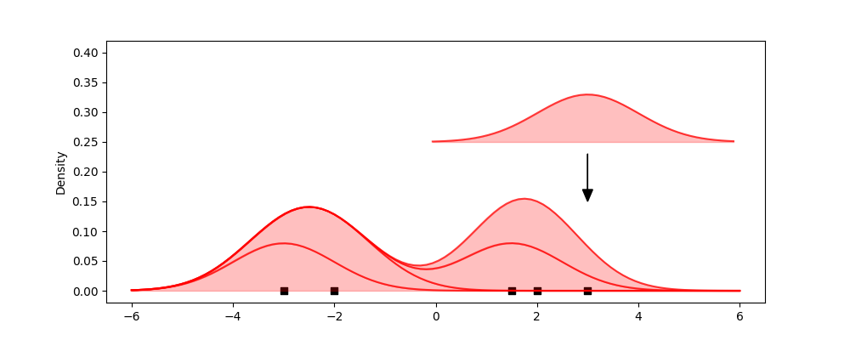
Density plot

Slide 51
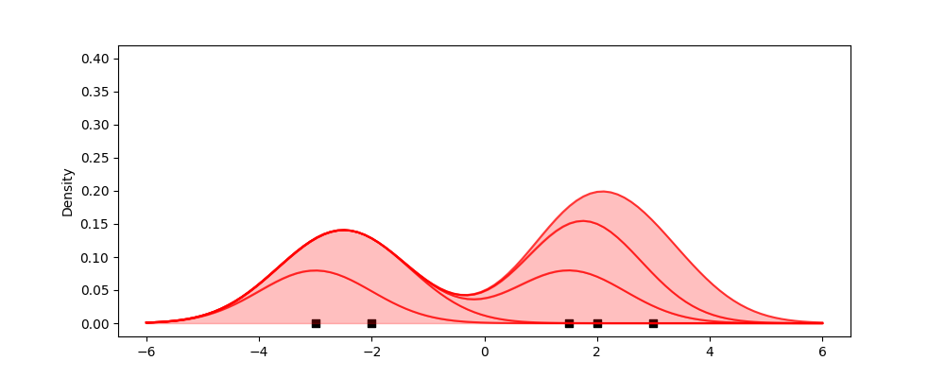
Density plot

Slide 52
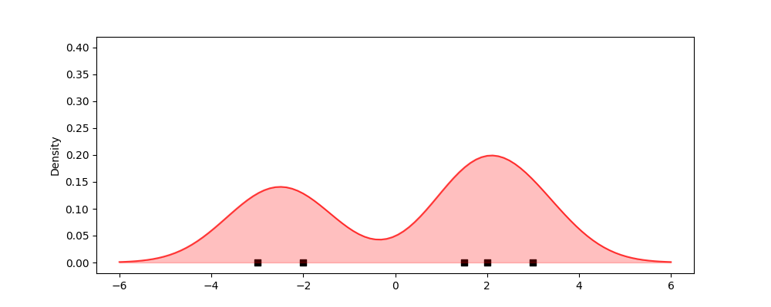
Density plot

Slide 53
Kernel Bandwidth

Slide 54
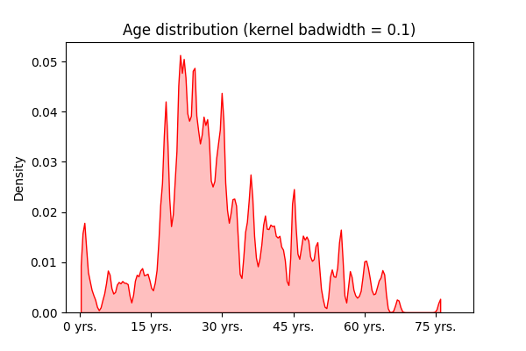
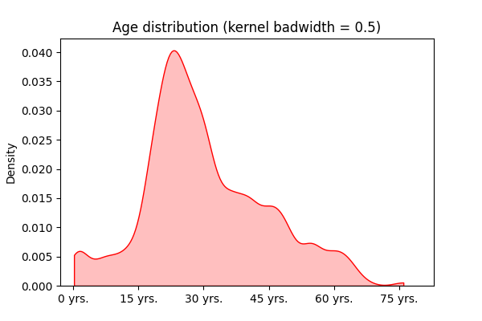
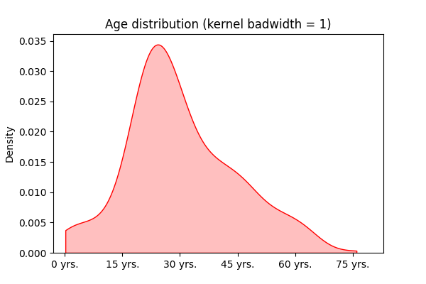
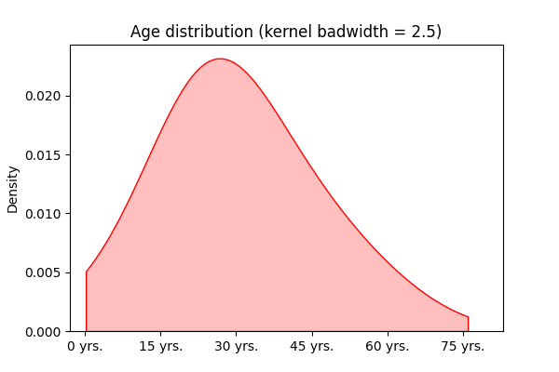

Slide 55
Comparing multiple distributions

Slide 56
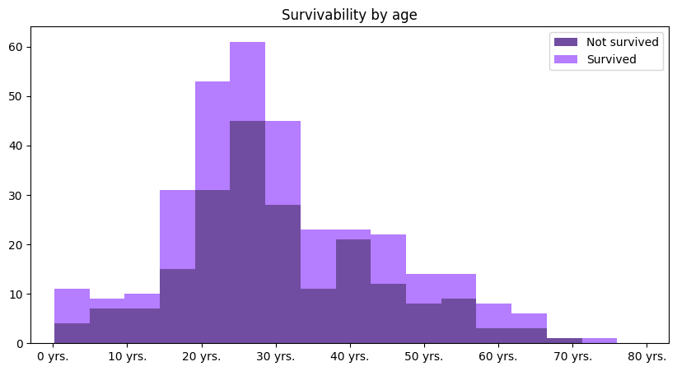
Stacked histogram

Slide 57
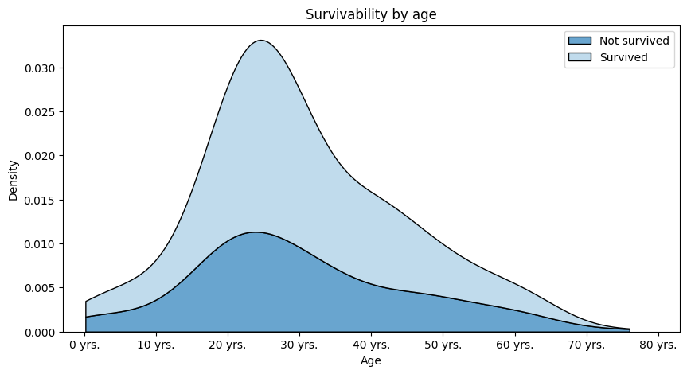
Stacked density plot

Slide 58
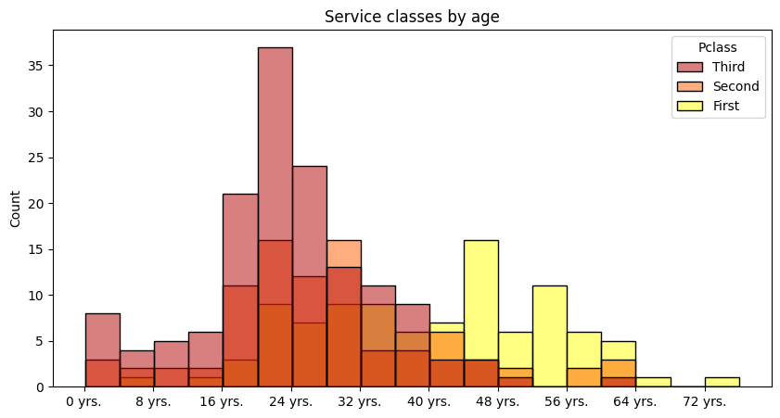
Overlapping density plot

Slide 59
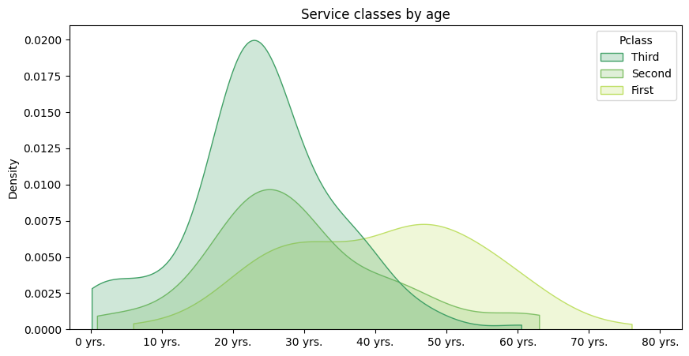
Overlapping density plot

Slide 60
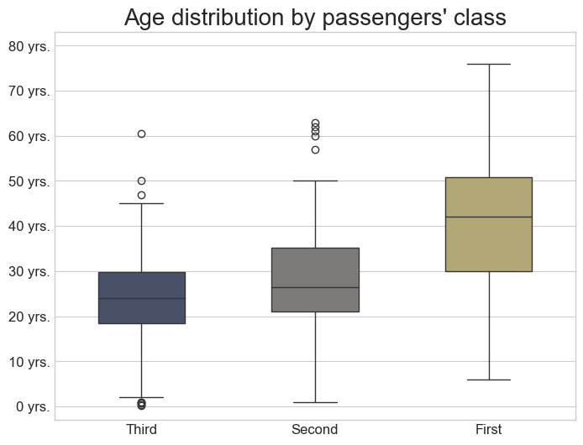
Box plots

Slide 61
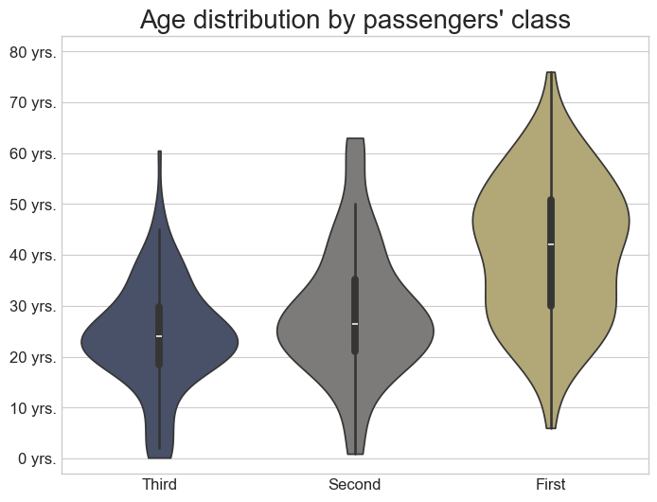
Violin plot

Slide 62
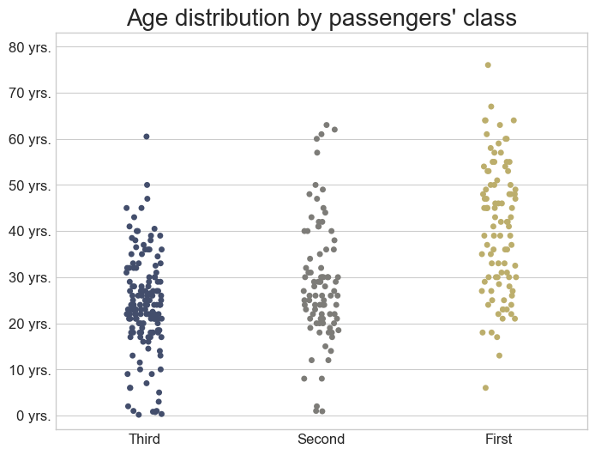
Strip plot

Slide 63
Logarithmic scale

Slide 64
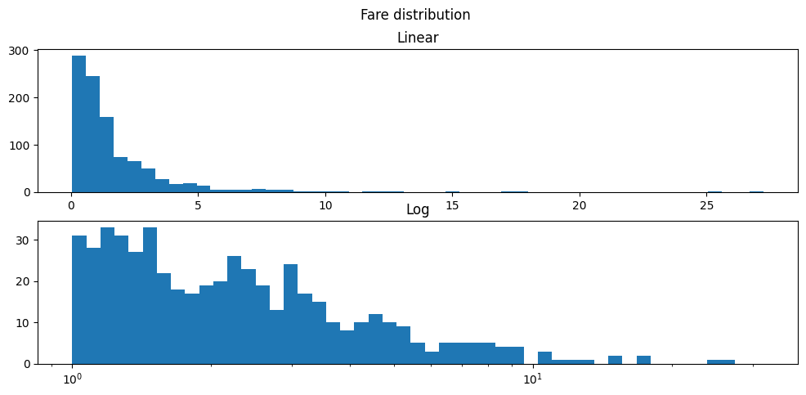
Logarithmic scale

Slide 65
Real vs theoretical distribution

Slide 66
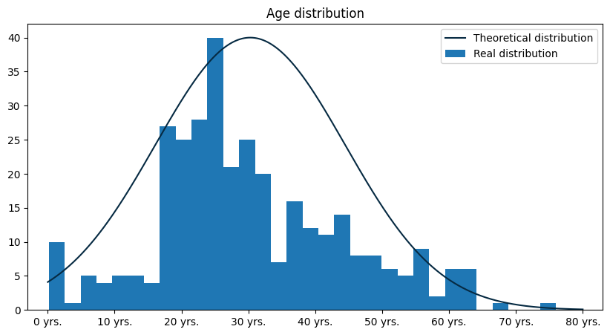
Real vs theoretical distribution

Slide 67

Real vs theoretical distribution

Slide 68
Frequently made mistakes

Slide 69


Incorrect color scale

Slide 70

Informing about missing data

Slide 71

Informing about missing data

Slide 72

Informing about missing data

Slide 73

Manipulating scale

Slide 74

Manipulating scale

Slide 75

Manipulating scale

Slide 76

Manipulating scale

Slide 77

Manipulating scale

Slide 78

Too many informations

Slide 79

Too many informations

Slide 80
References
Information sources:
[1] Wes McKinney, Python for Data Analysis, 3E (2022), Wes’s Blog
[2] Claus O. Wilke, Fundamentals of Data Visualization (2019), Claus Website
[3] Jarosław Drapala, Kernel Density Estimator explained step by step (2023), Medium - Towards Data Science
[4] 3Blue1Brown (Grant Sanderson), Why π is in the normal distribution (beyond integral tricks) (2023), Youtube
[5] Reveal BI, The Importance of Data Visualizations (2020), Youtube
Data sources:
[5] Brenda N, Titanic dataset (2021), Kaggle
[6] Główny Urząd Statystyczny, Obwieszczenie w sprawie wysokości przeciętnego miesięcznego wynagrodzenia brutto w gospodarce narodowej w województwach w 2022 roku (2023), GUS
[7] Aleksandr Glotov, Car Prices Poland (2021), Kaggle
Other:
[8] My private notes about data visualization an examples
Presentation author: Maksymilian Norkiewicz

